Slide 1
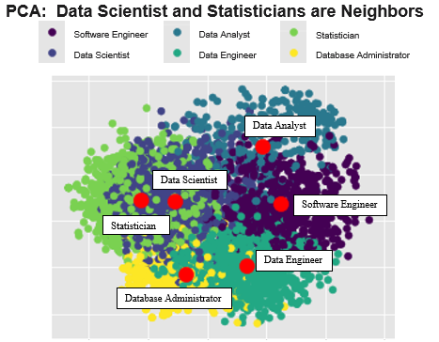
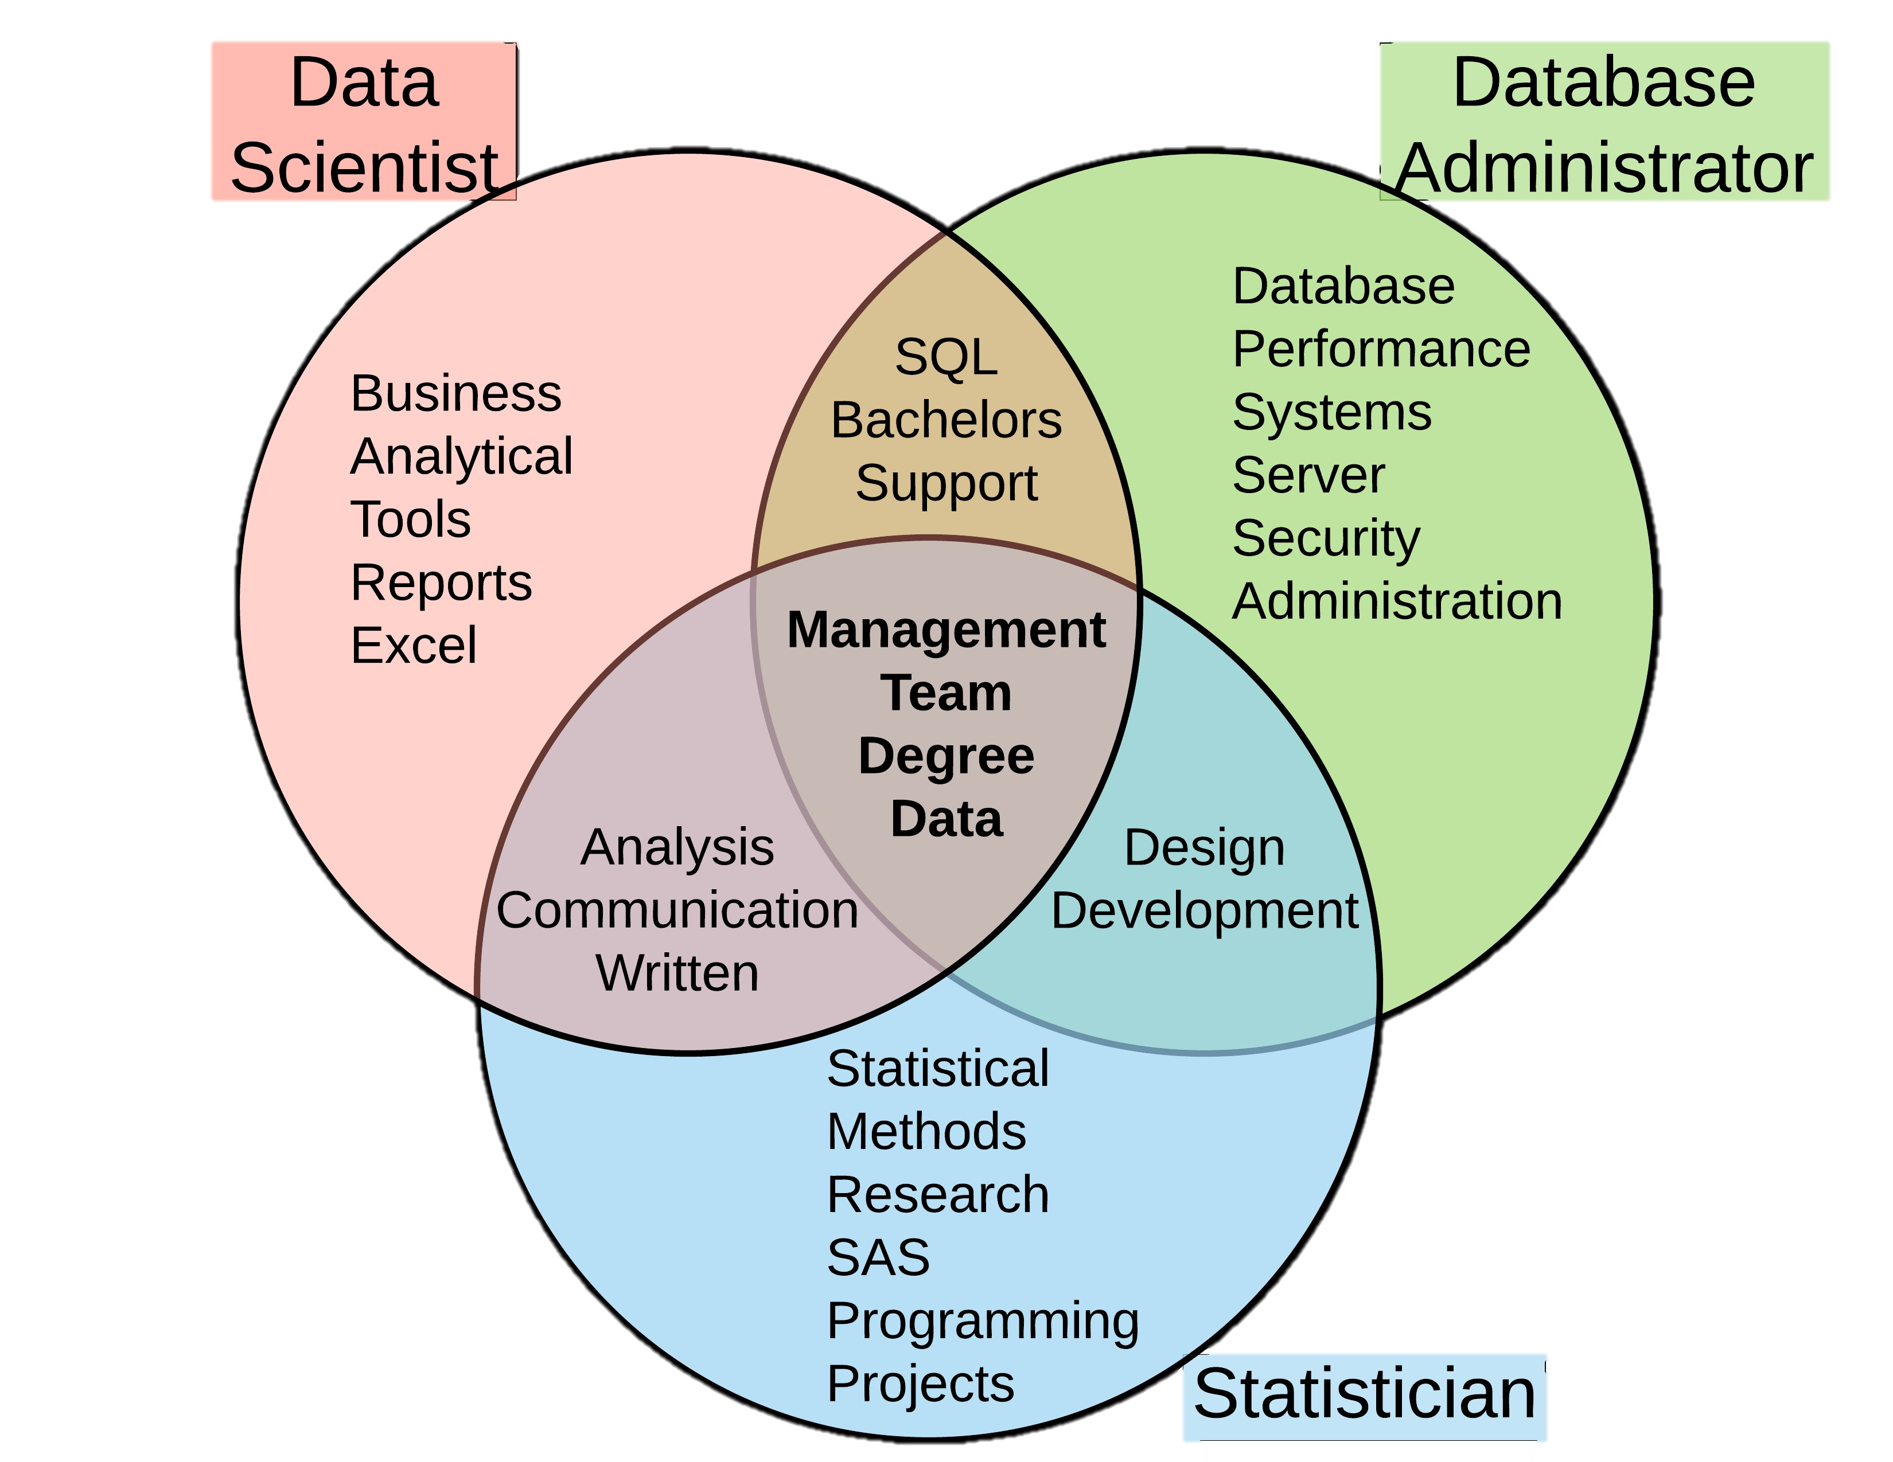
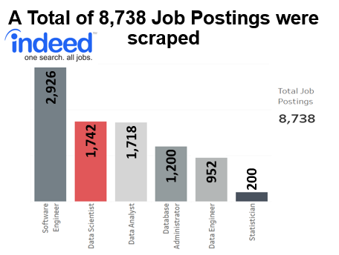
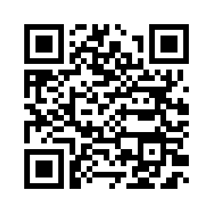



Who or What is a Data Scientist?
Non-Cognitive Predictors of Student Success: A Predictive Validity Comparison Between Domestic and International Students
Non-Cognitive Predictors of Student Success: A Predictive Validity Comparison Between Domestic and International Students
A Data Science Approach to Define a Data Scientist
INTRO:
If you are reading this, there is a high confidence our capstone is relevant to you. The ‘who is’ and ‘what is’ a Data Scientist is unclear – which leads to unmet expectations, misfit hires, and lost time/resources for employers, employees, and applicants. Using state-of-the-art NLP and Machine Learning on 8,000+ job postings, we arrive at the features that define the ‘what is’ and associate a couple of other job titles to figure out the ‘who is’ a Data Scientist.
METHODS:
Web scrapped 8,000+ job postings to form data set
Transform into feature vectors using Universal Sentence Encoder
Labeled clustering and neural network for classification
Reverse engineered results to find Features of Importance
Interact with our data by visiting our Tableau Website
Andy Ho An Nguyen Jodi Pafford
Dr. Robert Slater
Master of Science in Data Science
Southern Methodist University
Dallas, TX 75375, USA
Notes:
Notes:
In Powerpoint, click View > Guides
Keep text within gutter guides.
Author list: Don’t split names onto two lines (e.g., “Jimmy [break] Smith”). If that happens, use a new line, unless you need the space. Bold the first names of anybody who’s presenting in person.
Intro/methods/result: Do not drop below font size 28, but if you have extra space, jack up the font size until the space is full.
Do not use color in the sidebars except in graphs/figures. It’ll pull attention from the center and slow interpretation for passersby.

Slide 2
Notes: 1. Correct fonts won’t load until you open this in PowerPoint (e.g., if you’re previewing this in your browser it’ll look uglier than it actually is). 2. Generate QR codes here: https://www.qrcode-monkey.com/

